Slide 1
Slide Breakdowns
5 Minute Presentation Time
Title slide with all names, pictures and website/github urls (10 seconds)
Reminder of the project focus (20 seconds)
Daniel
Prioritized Sprint Goals (20 seconds)
Daniel
Major Sprint achievements/Feedback from Project Sponsor (20 seconds)
Colleen
Project Backlog and Sprint Backlog including cyber security related items and assessment (40 seconds)
Ryan
What was not completed / Lessons Learned (40 seconds)
Nick
Contribution by each team member (2 minutes)
Task breakdown (25 seconds each)
Short Video Demo (30 Seconds)
Sam
print 1 presentation content
◼ Title slide with all names, pictures and website/github urls
◼ Reminder of the project focus
◼ Prioritized Sprint Goals
◼ Major Sprint achievements/Feedback from Project Sponsor
◼ Project Backlog and Sprint Backlog including cyber security related items and assessment
◼ What was not completed (sprint 3 significant remaining work)/Lessons Learned
◼ AI tool(s) used and how they contributed to your productivity
◼ Contribution by each team member
◼ Live Demo of features (Sprint 1 may not have a real demo but a demonstration of what you have so far)
Sprint 1 Submission Checklist
The following documents should be POSTED on the Project website and submitted via Blackboard:
Project planning document for sprint
Project backlog snapshot
Sprint backlog
Sprint presentation
Scrums documented in discussion group
All source code changes committed to Github
Students will present using submitted slides downloaded from blackboard
◼ 5 minutes
◼ Everyone should talk and present their contributions
Presentation criteria:
Each rubric is broken into 3 parts. The first is the content. The content of Sprint 1 presentation is listed above. The second part focuses on slides and considers graphics, mechanics and organization. The third part is specific to each person and considers presentation skills (elocution, etc) and knowledge. The knowledge part doesn’t always come into play because we don’t have time to ask each person a question. However, sometimes it is clear that a student does not know what is going on with the project
Notes:
Ryan

Slide 2
Driveability Website
Samuel Wisnoff, Colleen Grimshaw,
Nicholas Yeager, Ryan Douglas,
Daniel Szurek

Slide 3
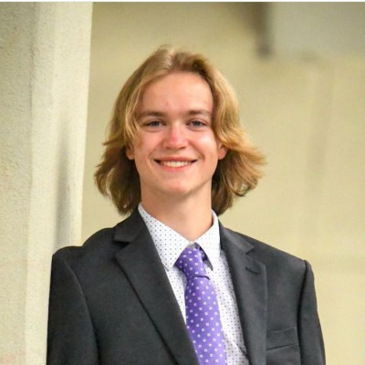
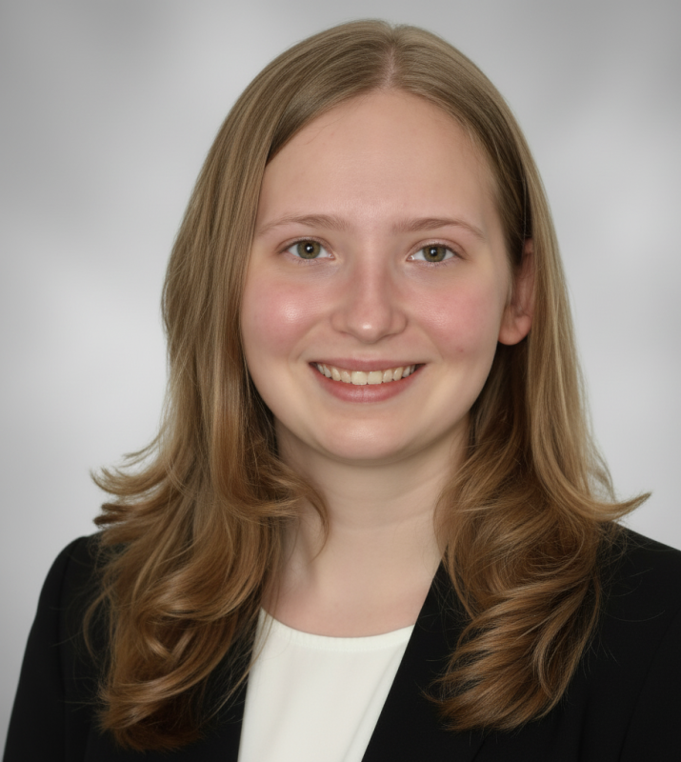
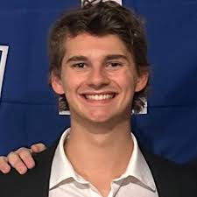
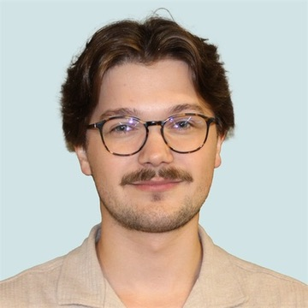
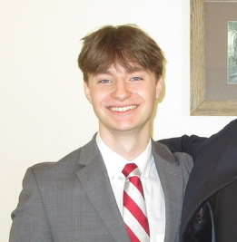
Nicholas Yeager
Colleen Grimshaw
Samuel Wisnoff
Daniel Szurek
Ryan Douglas
Website URL: https://driveabilitycapstone.netlify.app/
Notes:
The project Github requires an NDA to access

Slide 4
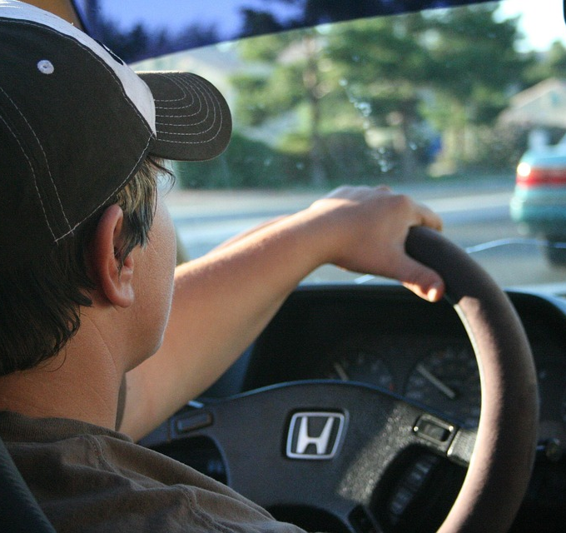
Project Focus
Develop a website that acts as a forum and guide for impaired individuals looking for a comprehensive resource on driving with physical impairments.
Notes:
Daniel

Slide 5
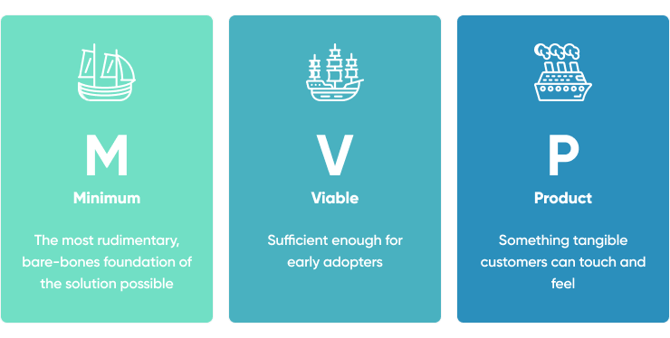
Sprint 2 Goals
Create a Minimum Viable Product
Have review process working end to end, with reviews submitted for approval, approved by admin, and published.
Have profile process working end to end, with users requesting to be reviewers, admin approves, and status changing..
Notes:
Daniel

Slide 6
Sprint Achievements and Sponsor Feedback
Achievements
Sponsor Feedback
Added new frontend functionality via a resources section & drafting ability
Admins now have ability to remove malicious actors from userbase
Set up API to connect backend and frontend
On pace based on pre-determined Sponsor Sprint 2 expectations
Wanted a minimum viable product in order to begin Beta testing
Proceeding with authoring initial blog posts and first batch of website content
Touching base with Alabama Adapted Athletics to ensure alignment with project goals
Notes:
Colleen

Slide 7
Project Backlog
Task | Assignee | Status
Remove demo/mock login fallback from AuthContext | TBA | Planned
Image upload for reviews | TBA | Planned
Production ready secrets | TBA | Planned
Add HTTPS enforcement for production | TBA | Planned
Email service: implement password reset emails | TBA | Planned
Implement Initial Website Content | TBA | Planned
Website Beta Deployment | TBA | Planned
Remove/secure .env credentials | TBA | Planned
Video player for articles | TBA | Planned
Remainder focused on preparing for beta-testing
Includes implementing initial content from sponsor:
”How To” tutorials
Hand Control walkthroughs from Alabama Adapted Athletics Staff
Initial round of reviews
Notes:
Ryan

Slide 8
Sprint Backlog
High-Level Task | Description / Sub-Tasks | Status
Frontend Reorganization | Updated Resources page, modified pages available to users, changes in the workflow for user usage of website.
Admin Functionality | Additional abilities to manage/control user privileges
User Functionality | Additional QOL features, bookmarking reviews/articles, more visibility during review approval process
Backend Compliance | Updated queries for resource page, backend functionality for the admin and user workflow updates
Cybersecurity | Address cybersecurity concerns brought up by the cybersecurity team and our own development

Slide 9
Cybersecurity Considerations
Issue
Rate-Limiting
Mongoose Sanitization
XSS Attacks
Attackers can freely assign mongoose fields during a create() call
Attackers can inject scripts in the rich-text input fields
Brute Force attacks to gain passwords
Risk
Rate-Limit the number of login/reset password attempt
Strictly list allowable assignment fields, and match input fields to mongoose fields
Strip dangerous HTML tags using html-sanitize library
Solution

Slide 10
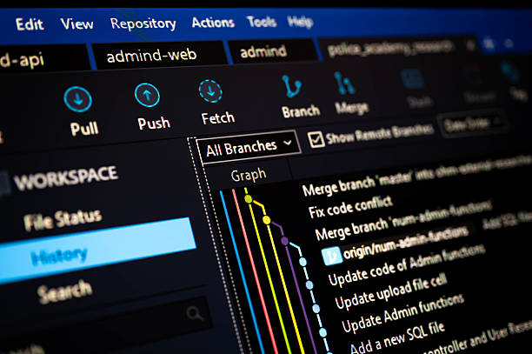
Lessons Learned
Difficulty in full stack integration
Discrepancy in task distribution by area
Amount of work necessary for MVP
Notes:
Nick

Slide 11
Task Breakdown

Slide 12
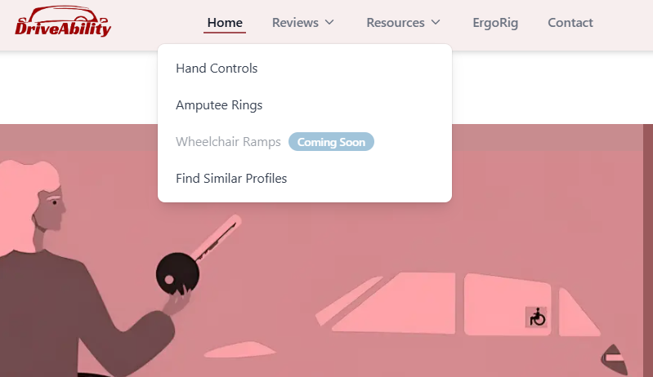
Colleen: User Oriented
5 Tasks Completed:
Removed the option for users to 'browse all profiles' & the related dropdown
Added a dropdown for resources
Added the ability to save a review for later
Retained user's ability to find others with similar profiles
Notes:
Colleen

Slide 13
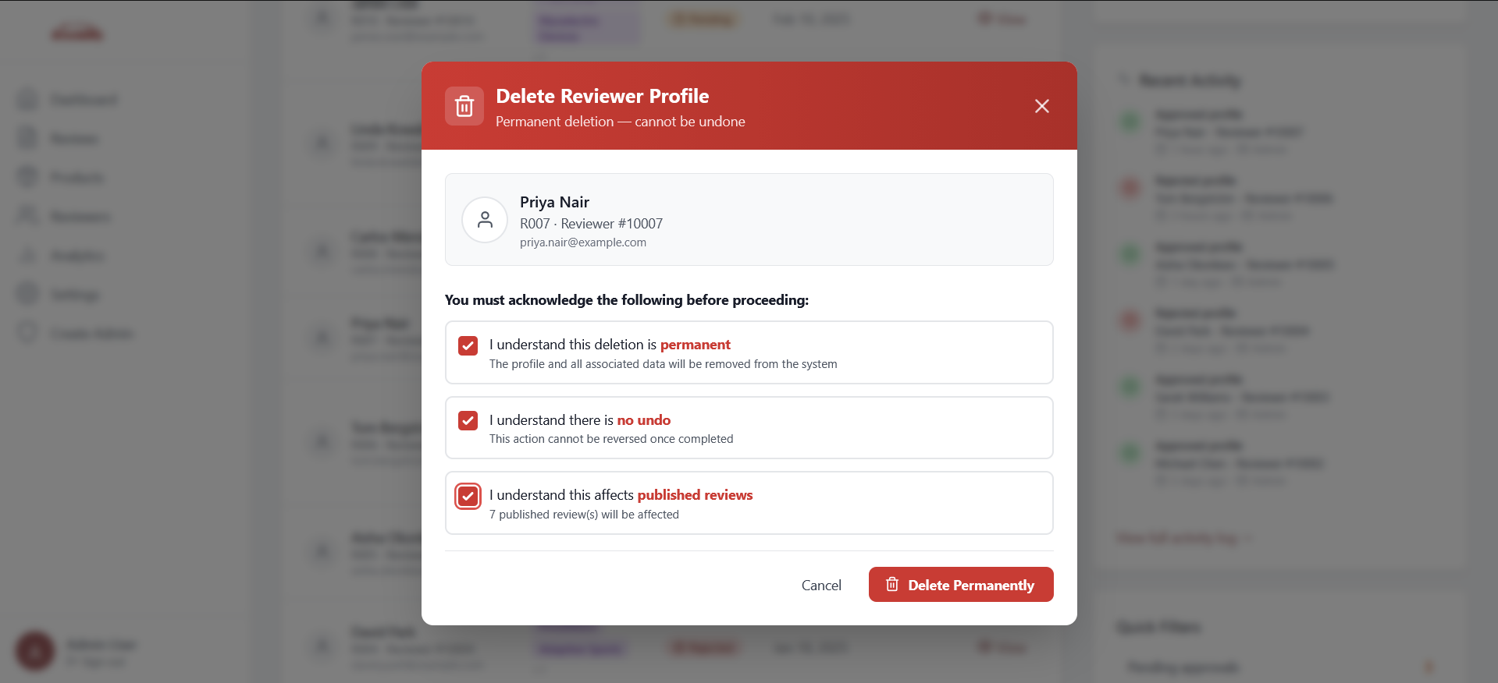
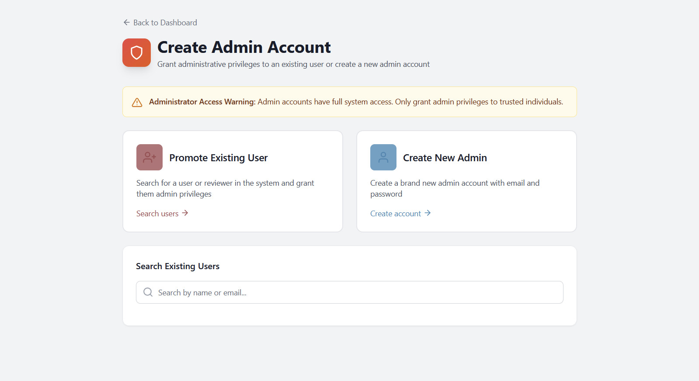
Nick: Admin Oriented
Tasks:
Added functionality for admin profile creation with assignment of capabilities
Implemented ability to remove users from system
Implemented ability to remove reviews from system

Slide 14

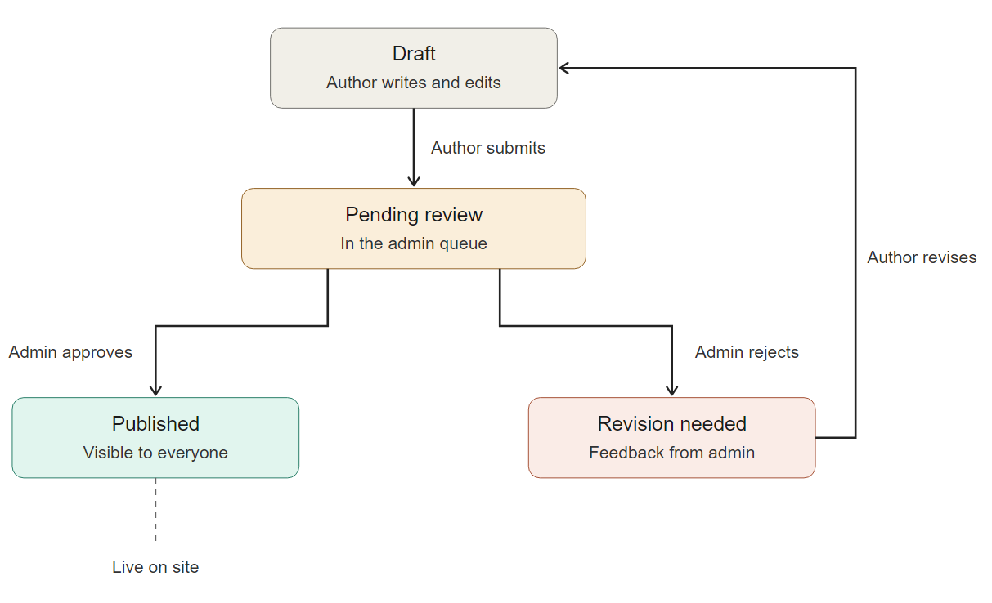
Sam: Review System and Lifecycle
Tasks:
User review system backend implemented with Express, TypeScript, and Mongoose
Mongoose queries for MongoDB: request reviews based on category, product, author, etc
Review process:
Drafts submitted for approval
Admin approved or rejected for revisions
Save for later feature for reviews: bookmark reviews and remove bookmarks
Authentication middleware on routes
Test suites created: tested using in-memory MongoDB
Notes:
Sam

Slide 15
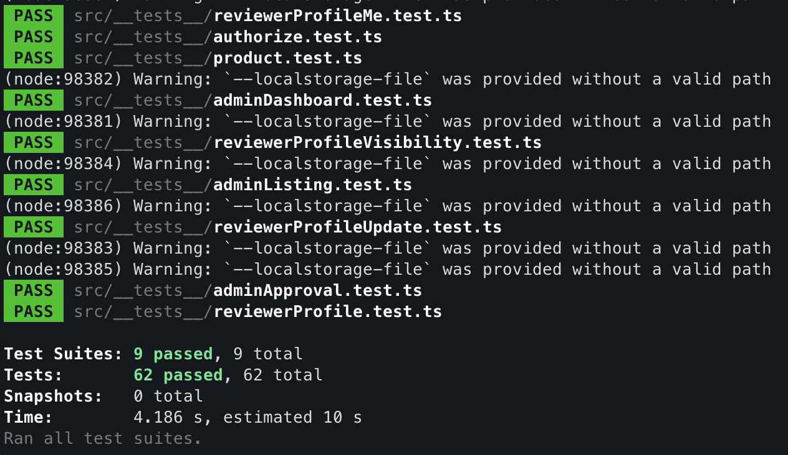
Ryan: Cybersecurity Focused
Tasks:
HTML Text Input XSS Sanitization
Mongoose Query Input Sanitization
Rate-Limiting Requests

Slide 16

Daniel: Full Stack
The full stack role focused on bridging the gap between the frontend and backend developers, and ensuring that features worked end to end.
This included:
Completing the end to end behavior of review creation, approval, and publishing
Completing the workflow for reviewer application submission, approval, and user promotion
Fixing any merge conflicts between branches

Slide 17

Technologies Used and Personal Experience
React and Typescript for the frontend
Modular, easy to consolidate HTML, CSS, and Typescript
Docker for containerization
Makes testing of application easy, also portable and OS independent
Mongoose for MongoDB interaction
Easy to understand schema for data objects
Express manages HTTP methods
Once understood, provides a set of tools for backend design

Slide 18
Demo
Notes:
Sam
Explanation of what is currently implemented.

